Slide 1
CEN 3078 Computer Security
Module 1 – Application and Network Analysis

Slide 2
Network and application layers – security concepts
Packet sniffing and spoofing
Intrusion detection systems
Legal and ethical issues
Module 1

Slide 3
Classes of Intruders – Cyber Criminals
Hackers/Crackers: Individuals or members of an organized crime group with a goal of financial reward
Verizon found that 92% of the breaches they investigated were by outsiders, with 14% by insiders, and with some breaches involving both outsiders and insiders
Insiders were responsible for a small number of very large dataset compromises
Their activities may include:
Identity theft
Theft of financial credentials
Corporate espionage
Data theft
Data ransoming
Typically they are young, often Eastern European, Russian, or southeast Asian hackers, who do business on the Web
They meet in underground forums (e.g., DarkMarket.org and theftservices.com) to trade tips and data and coordinate attacks

Slide 4


Classes of Intruders – Activists
Are either individuals, usually working as insiders, or members of a larger group of outsider attackers, who are motivated by social or political causes
Aim of their attacks is often to promote and publicize their cause typically through:
Website defacement
Denial of service attacks
Theft and distribution of data that results in negative publicity or compromise of their targets (e.g., Edward Snowden, Chelsea Manning)
Also know as Hacktivists - Skill level is often quite low sometimes (i.e., script-kiddies) but there are large skilled groups
(e.g., Anonymous Group, LulzSec)

Slide 5
Examples of Intrusion
NIST SP 800-61 (Computer Security Incident Handling Guide) List:
Remote root compromise
Web server defacement
Guessing/cracking passwords
Copying databases containing credit card numbers
Viewing sensitive data without authorization
Running a packet sniffer
Distributing pirated software
Using an unsecured device to access internal network
Impersonating an executive to get information
Using an unattended workstation
…

Slide 6
Intruder Behavior
Target acquisition and information gathering
Initial access
Privilege escalation
Information gathering or system exploit
Maintaining access
Covering tracks
The techniques and behavior patterns of intruders are constantly shifting, to exploit newly discovered weaknesses and to evade detection and countermeasures
E.g., they start with a phishing attack that results in the installation of malware that steals login credentials that eventually results in the compromise of a Point-of-Sale terminal

Slide 7
Definitions
Security Intrusion:
Unauthorized act of bypassing the security mechanisms of a system
Intrusion Detection:
A hardware or software function that gathers and analyzes information from various areas within a computer or a network to identify possible security intrusions
Intrusion Detection Systems (IDSs) / Intrusion Prevention Systems (IPSs):
Designed to aid countering intrusion threats and are reasonably effective against known, less sophisticated attacks (e.g., large-scale email scams)
They may not be effective against the more sophisticated, targeted attacks by some criminal or state-sponsored intruders (e.g., new, zero-day exploits)
They are part of a defense-in-depth strategy that may also include encryption of sensitive information, detailed audit trails, strong authentication and authorization controls, and active management of application and network security

Slide 8
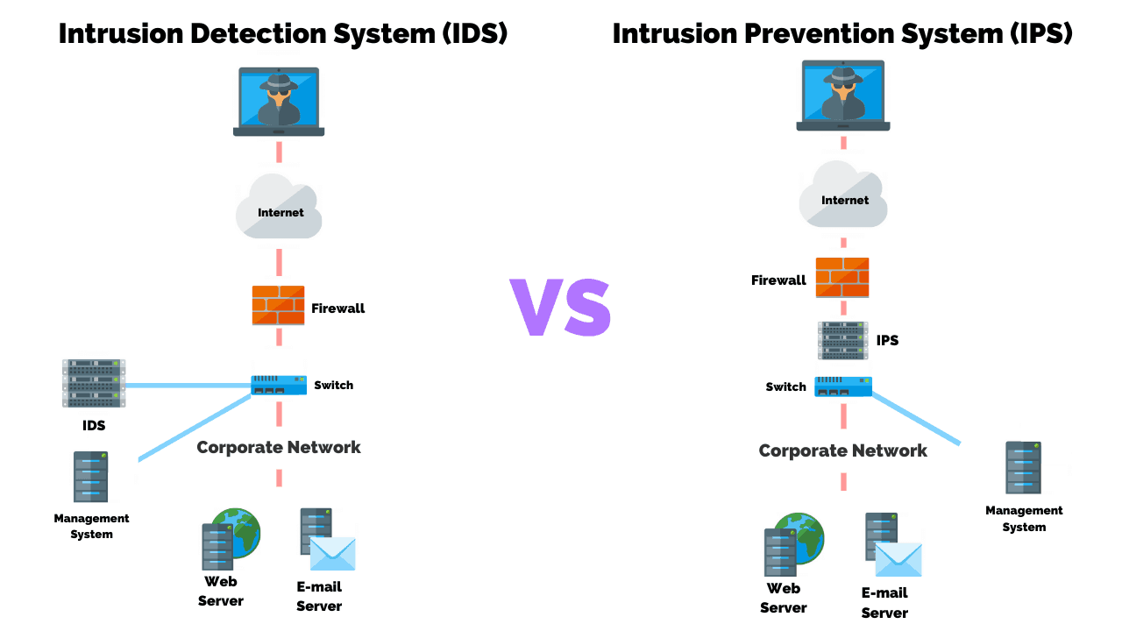
IDS vs IPS

Slide 9
Intrusion Detection System
Host-based IDS (HIDS)
Monitors the characteristics of a single host and its users for suspicious activity
Network-based IDS (NIDS)
Monitors network traffic and analyzes network, transport, and application protocols to identify suspicious activity
Distributed or hybrid IDS
Combines information from a number of sensors, often both host and network based, in a central analyzer and user interface that is able to better identify and respond to intrusion activity
Comprises three logical components:
Sensors – collect data (e.g., network packets, log files, and system call traces)
Analyzers – read sensor data and determine if intrusion has occurred, archive evidence for future analysis, and guide actions
User interface – view output or control system behavior

Slide 10
Analysis Approaches
Signature/Heuristic detection
Anomaly detection
Minimum human supervision
Recover from crashes and reinitializations
Self-monitor and detect intruder modification
Involves the collection of data relating to the behavior of legitimate users over a period of time
Current observed behavior is analyzed to determine whether this behavior is that of a legitimate user or that of an intruder
Can detect unknown, zero-day attacks, as it starts with known good behavior and identifies anomalies to it – but false alarms are common!
Uses a set of known malicious data patterns or attack rules that are compared with current behavior
Also known as misuse detection
Can only identify known attacks for which it has patterns or rules

Slide 11
Anomaly Detection Classification Approaches
Statistical
Analysis of the observed behavior using univariate, multivariate, or time-series models of observed metrics
Knowledge based
Approaches use an expert system that classifies observed behavior according to a set of rules that model legitimate behavior
Machine-learning
Approaches automatically determine a suitable classification model from the training data using data mining techniques
Change-detection principles are used
Difficulty and time consuming to develop a high-quality knowledge from the data, and requires human experts to assist with the process
Training process typically requires lots of sanitized data, and takes significant time and computational resources
Minimum human supervision
Recover from crashes and reinitializations
Self-monitor and detect intruder modification
Two key issues that affect the relative performance of these alternatives are: (i) the efficiency/effectiveness, and (ii) cost of the detection process

Slide 12
Machine Learning Approaches Proposed for an IDS
Bayesian networks: Encode probabilistic relationships among observed metrics
Markov models: Develop a model with sets of states, some possibly hidden, interconnected by transition probabilities
Neural networks: Simulate human brain operation with neurons and synapse between them, that classify observed data
Fuzzy logic: Uses fuzzy set theory where reasoning is approximate, and can accommodate uncertainty
Genetic algorithms: Uses techniques inspired by evolutionary biology, including inheritance, mutation, selection and recombination, to develop classification rules
Clustering and outlier detection: Group the observed data into clusters based on some similarity or distance measure, and then identify subsequent data as either belonging to a cluster or as an outlier
Minimum human supervision
Recover from crashes and reinitializations
Self-monitor and detect intruder modification

Slide 13


Network Security Tools
Wireshark - monitors all information entering and leaving the computer
Snort – highly configurable and portable host-based and network-based IDS; detects intrusions into the system and logs them for further examination on servers & networks
http://www.wireshark.org
http://www.snort.org

Slide 14
Network, IoT, and Cybersecurity Lab
(EagleCyberNest @ HE 303)
Is Hiring!!!

Slide 15
Network, IoT, and Cybersecurity Research Lab
We’re the 1st student research lab focus on network and cybersecurity in the computing and software engineering department!!!
This research job counts for FGCU service-learning hours!
We have tons of network devices and resources (e.g., routers, switches, racks, high-speed network)!!!
We even have drones!
Come and join us! Email your resume now! cqu@fgcu.edu

